Slide 1

Presented by: PIYUSH KUMAR SULTANIA Link: https://github.com/sultania-p/database-code_modeling
FLIGHT BOOKING MANAGEMENT SYSTEM

Slide 2
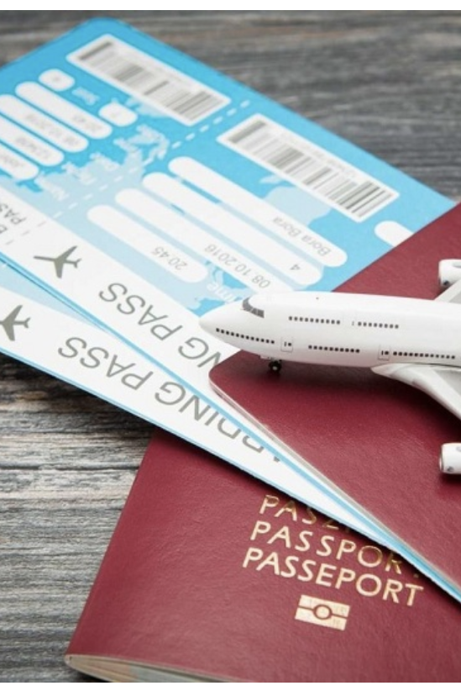
OBJECTIVE
This project aims at enhancing the relationship between the customers and airlines via the Flight Reservation System.
The system allows a passengers to perform various functions such as managing the flight bookings, and customer information.
Incorporate the COVID-19 digital test reports and vaccination details of the passengers for convenient and a safe journey.

Slide 3
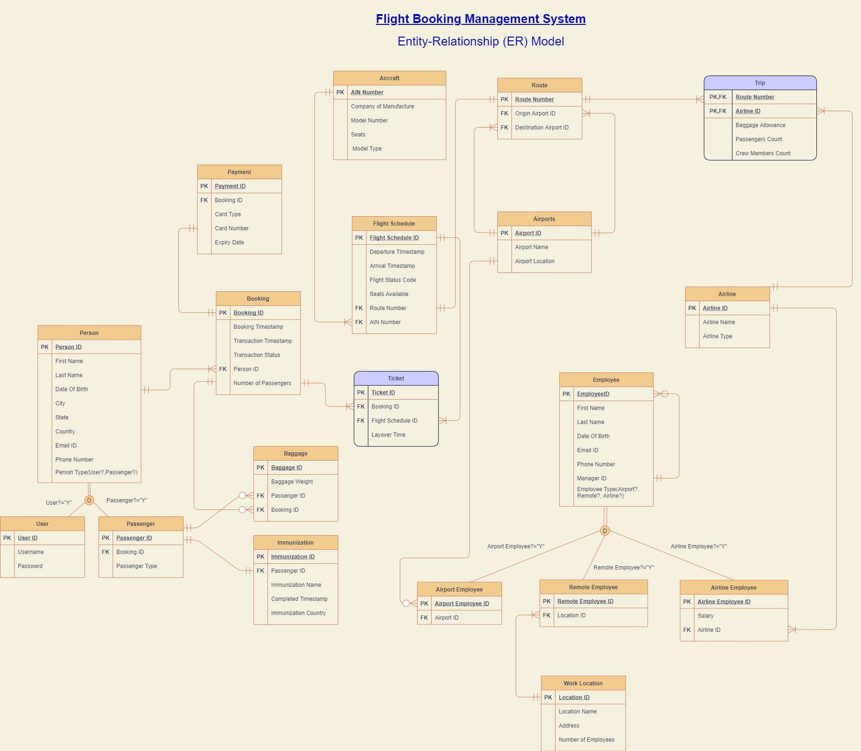

Slide 4

Design document
A total of twenty entities have been created and corresponding relationships have been established in the best possible normalized form which is suited for a database.
Attaching the design document with the entities, attributes with the description for each entity.

Slide 5

SQL STATEMENTS
Twenty tables have been created with each table containing 10 records.
The tables present in the database have table level check constraints, clustered and non clustered indexes, encryption in column, computed columns.
Corresponding stored procedures, triggers and views have ben created with the available data from the database
DDL
DML
SP,View,Trigger

Slide 6
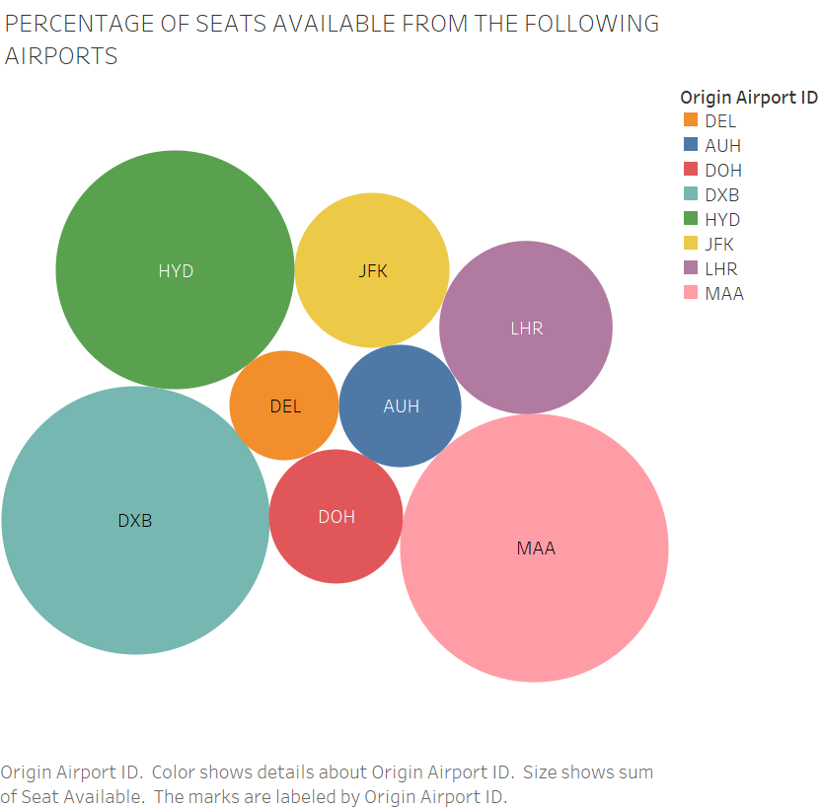
seats available at airports
The chart depicts the availability of seats in all the aircrafts from the originating airports.

Slide 7
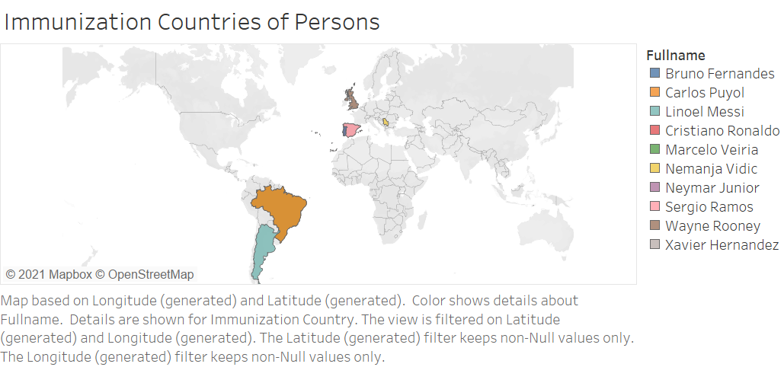
depicts the countries in which Passengers got vaccinated.

Slide 8
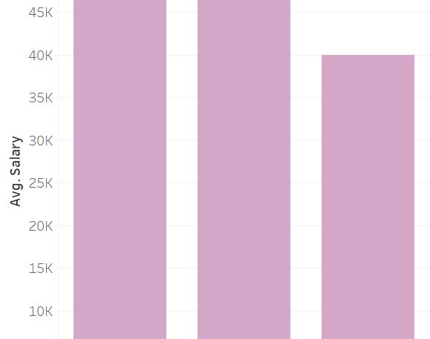
average salaries of the respective employee types
The graph depicts the average salary of the below three employee categories.
Airline Employee
Airport Employee
Remote Employee

Slide 9
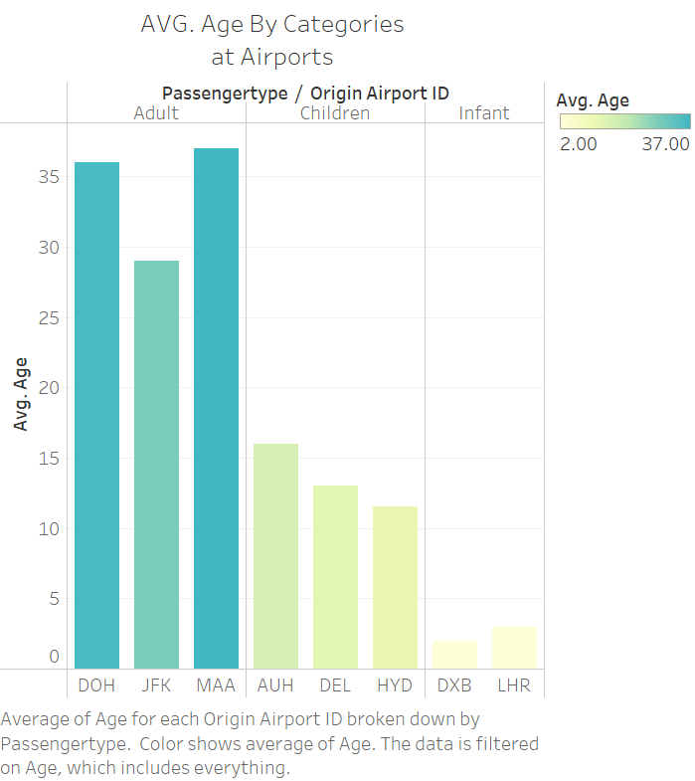
Average age of passengers at the respective Origin Airports
The graph depicts the average age of the passengers boarding at the respective airports and they are categorized into the following three types.
Adult
Children
Infant

Slide 10
